Slide 1


19EC786
Analog VLSI design

Slide 2
19EC786 – Analog VLSI design
Syllabus
UNIT I BASIC MOS DEVICES 9
Depletion region of PN junction - Band diagram of MOS capacitor – Accumulation, Depletion, inversion region- Large and small signal behavior of MOSFET- short channel effects in MOS transistors – weak inversion in MOS transistors- substrate current flow in MOS transistor.
UNIT II HIGH FREQUENCY CMOS AMPLIFIERS AND CURRENT MIRROR CIRCUITS 9
Common source, common drain, common gate. Differential amplifiers-Cascode amplifiers-Current amplifiers–power amplifiers- Current sources and sinks ,MOS Current Mirrors – Simple, Cascode, Wilson and Widlar current source.
UNIT III CMOS OPERATIONAL AMPLIFIER 9
Design of CMOS Op amps - Compensation of Op amps- Low voltage Op amps - Low noise Op amps Two stage MOS Operational Amplifiers with Cascode, MOS Telescopic - Cascode Operational Amplifier, MOS Folded Cascode and MOS Active Cascode Operational Amplifiers.
UNITIV COMPARATORS AND SWITCHED CAPACITOR CIRCUITS 9
Characterization of a Comparator -two-Stage Open-Loop Comparators - Improving the Performance of Open-Loop Comparators-Discrete-Time Comparators - High-Speed Comparators- Switched Capacitor Circuits – Switched Capacitor Amplifiers - Switched Capacitor Integrators
UNITV A/D AND D/A CONVERTERS 9
Characterization of D/A converters- Parallel D/A converters-extending the resolution of parallel D/A converters- Serial D/A converters- Characterization of A/D converters-Serial A/D converters- Medium and high speed A/D converters.

Slide 3
UNIT III CMOS OPERATIONAL AMPLIFIER
UNIT III CMOS OPERATIONAL AMPLIFIER
Design of CMOS Op amps
Compensation of Op amps
Low voltage Op amps
Low noise Op amps Two stage MOS Operational Amplifiers with Cascode, MOS Telescopic
Cascode Operational Amplifier
MOS Folded Cascode
MOS Active Cascode Operational Amplifiers.

Slide 4
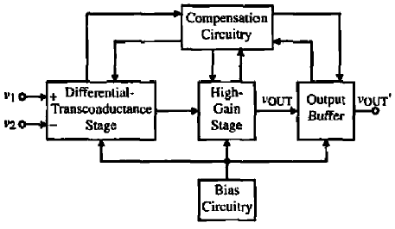
UNIT III CMOS OPERATIONAL AMPLIFIER
Operational Amplifiers
Ideal Op Amp
Ideally, an op amp bas infinite differential-voltage gain, infinite input resistance, and zero output resistance.
Normally, a good portion of the overall gain is provided by the differential-input stage, which improves noise and offset performance.
If the differential-input stage does not perform the differential-to-single-ended conversion, then it is accomplished in the second-stage inverter.
If the op amp must drive a low-resistance load, the second stage most be followed by a buffer stage whose objective is to lower the output resistance and maintain a large signal swing.
Bias circuits are provided to establish the proper operating point for each transistor in its quiescent state.
General two-stage op amp.

Slide 5
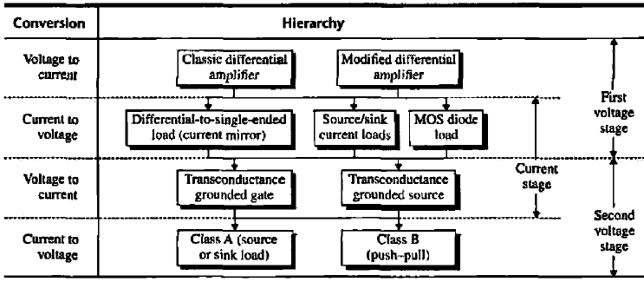
UNIT III CMOS OPERATIONAL AMPLIFIER
Operational Amplifiers
Categorization of CMOS Op Amps

Slide 6
UNIT III CMOS OPERATIONAL AMPLIFIER
Operational Amplifiers
Performance Parameters
Gain(Precision)
Small-signal Bandwidth(Speed): 3-dB/fu
Large-Signal behavior (e.g. slew rate)
Output Swing (especially for Low supply voltage)
Linearity
Noise and offset
Supply Rejection
Input CM Range, Input/Output Impedance
Power dissipation

Slide 7
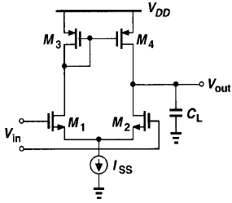
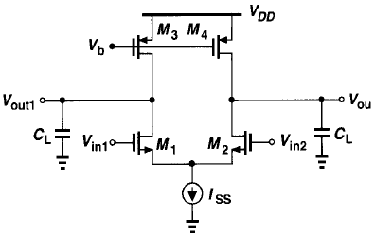
UNIT III CMOS OPERATIONAL AMPLIFIER
Operational Amplifiers
One-Stage Op Amps
Low-frequency gain: Av = g_{mN} (r_{oN} || r_{oP})
Bandwidth: usually proportional to 1/(CL*Rout)
Output Swing (single-side): V_{DD}-3V_{OV}
Mirror pole in single-ended circuit
Noise: two input devices and two “load’ devices

Slide 8
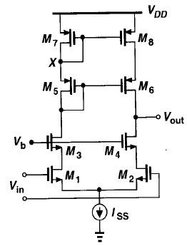
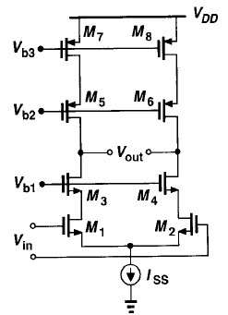
UNIT III CMOS OPERATIONAL AMPLIFIER
Operational Amplifiers
Cascode Op Amps
In Order to achieve high gain, the differential Cascode configurations can be used.
Low-frequency gain:
Output Swing (single-side): V_{DD}-5V_{OV}
Mirror pole at node X (at node Y) in single-ended
Difficult to short telescopic op amp output to input
Noise: input noise mainly has four devices contribution

Slide 9
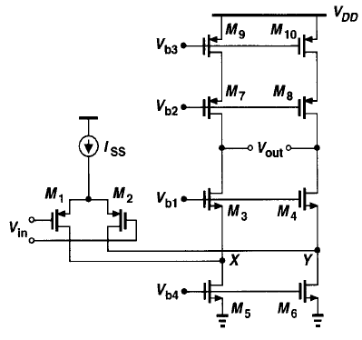
UNIT III CMOS OPERATIONAL AMPLIFIER
Folded Cascode Operational Amplifiers with Cascode PMOS Loads
NMOS input → Higher gain
NMOS input → Lowering the pole at folding point
PMOS input is less sensitive to flicker noise
Slighter Higher Output Swing than telescopic
Higher Power dissipation, lower voltage gain, lower pole frequency and higher noise
Input and output can be shorted: A better input CM range
M₁-M₃ & M₂-M₄ forms the folded active Cascode Amplifier.
M₇, M₈, M₉, M₁₀ are load Cascode Current Source.
M₅ & M₆ are Current Sink.

Slide 10
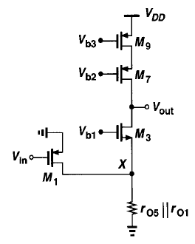
UNIT III CMOS OPERATIONAL AMPLIFIER
Folded Cascode Operational Amplifiers with Cascode PMOS Loads
I_{D3} = I_{D1} = g_{m1} V_{in} (Current Mirror has reflection of current)
I_{D3} = I_{out} = g_{m1} V_{in}
I_{out} / V_{in} = g_{m1} ------- (1)
Also,
R_{op} = g_{m7} (1+η) r_{o7} r_{o9} ------- (2)
Half circuit of Folded
Cascode Op Amps

Slide 11
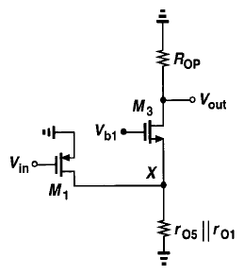
UNIT III CMOS OPERATIONAL AMPLIFIER
Folded Cascode Operational Amplifiers with Cascode PMOS Loads
D₃
I_{x}
V_{x}
r_{o3}
g_{mb3} V_{gs3}
g_{m3} V_{gs3}
R_{op}
G₃
S₃
R_{s}
Equivalent Circuit with Output Open
(Similar to Common Gate amplifier)
R₀ = r_{o} + R_{s} + g_{m} (1+η) R_{s} r_{o} ------(3)

Slide 12
UNIT III CMOS OPERATIONAL AMPLIFIER
Folded Cascode Operational Amplifiers with Cascode PMOS Loads
R_{out} = R_{op} || R_{o} ------- (4)
r_{o} = r_{o3}; R_{s} = r_{o1} || r_{o5}, Sub. these in eqn. (3) & (5)
R_{out} = R_{op} || (r_{o1} || r_{o5}) + r_{o3} + g_{m3} (1+η) r_{o3} (r_{o1} || r_{o5}) ------- (5)
Sub. R_{op} in (5),
R_{out} = g_{m7} (1+η) r_{o7} r_{o9} || (r_{o1} || r_{o5}) + r_{o3} + g_{m3} (1+η) r_{o3} (r_{o1} || r_{o5}) ----- (6)
R_{out} = g_{m7} (1+η) r_{o7} r_{o9} || (r_{o1} || r_{o5}) + r_{o3} + g_{m3} (1+η) r_{o3} (r_{o1} || r_{o5})

Slide 13
UNIT III CMOS OPERATIONAL AMPLIFIER
Folded Cascode Operational Amplifiers with Cascode PMOS Loads
Problem:
Draw one stage folded cascode op-amp. Assume, I_{ref} =100 μA, μ_{n}C_{ox} = 80 μA/V², μ_{p}C_{ox} = 40 μA/V², (W/L)_{p} = 55/1, (W/L)_{n} = 25/1, λ_{n} = λ_{p} = 0.02 V⁻¹, I_{D} = 50 μA.
Determine the differential amplifier gain and neglect the body effect.

Slide 14
UNIT III CMOS OPERATIONAL AMPLIFIER
Folded Cascode Operational Amplifiers with Cascode PMOS Loads
Solution:
Given:
I_{ref} =100 μA, μ_{n}C_{ox} = 80 μA/V², μ_{p}C_{ox} = 40 μA/V², (W/L)_{p} = 55/1, (W/L)_{n} = 25/1, λ_{n} = λ_{p} = 0.02 V⁻¹, I_{D} = 50 μA.
For the given, g_{m3} is n-channel, g_{m1} & g_{m7} are p-channel. We have to find Av = g_{m} R_{out}.
g_{m1} = √(2 I_{D} μ_{p}C_{ox} (W/L)_{p}) = 467.04 μA/V = g_{m7}
g_{m3} = √(2 I_{D} μ_{n}C_{ox} (W/L)_{n}) = 447.21 μA/V
r_{o1} = r_{o7} = r_{o9} = 1/(λ I_{D}) = 1 MΩ
r_{o9} = 1/(λ I_{ref}) = 0.5 MΩ
r_{o1} || r_{o5} = 0.33 MΩ
R_{out} = 113.03 MΩ
A_{v} = g_{m1} R_{out} = 53016.67

Slide 15
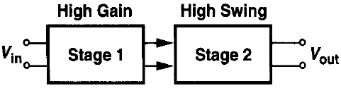
UNIT III CMOS OPERATIONAL AMPLIFIER
Two Stage Operational Amplifiers
Drawback of one-stage:
The one-stage op-amps allow the small signal current produced by the input pair to directly flow through the output impedance. Hence, the gain of these topologies, limited to the product of input pair trans-conductance and output impedance.
Cascoding of such circuits increases the gain while limiting the output swings.
Need:
In some applications, gain and the output swings must be large.
Ex.: For a supply of 0.9V, a single ended output swings up to 0.5V.
Two-stage advantage:
In the two stage op-amps the first stage providing a High gain and the second stage provides a large gain.

Slide 16
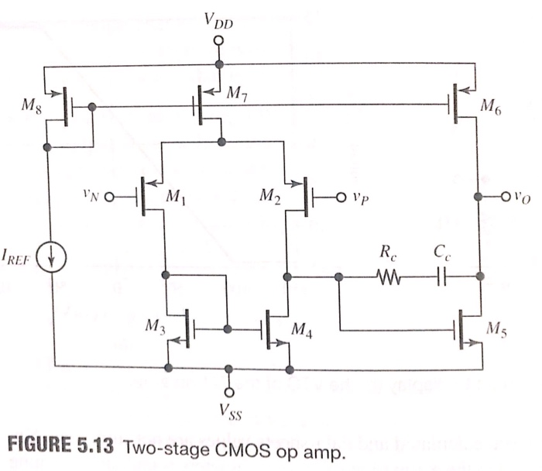
UNIT III CMOS OPERATIONAL AMPLIFIER
Two Stage Operational Amplifiers
It is otherwise named as
Steering Circuit.

Slide 17
UNIT III CMOS OPERATIONAL AMPLIFIER
Two Stage Operational Amplifiers
M₁-M₂ are differential pair with input V₁ and V₂.
M₃, M₄ are load for M₁-M₂.
M₇ & M₈ forms Current Source.
M₅ is a Current Source with a load M₇.
So, I₅ = I₆
From the diagram,
V_{gs8} = V_{gs7} = V_{gs6}; hence, I₇ = I₆ = I_{ref}.
Also, V_{gs3} = V_{gs4} & V_{gs1} = V_{gs2}; hence, I₄ = I₃ & I₁ = I₂
Then, I₇ = {(W/L)₇/(W/L)₆}I₆ ; I₅ = {(W/L)₅/(W/L)₄}I₄ ; I₅ = I₆
I₇ is divided in to equal parts in M₁ & M₂. So, I₇ = 2I₄
Then, {(W/L)₅/(W/L)₄} = 2{(W/L)₆/(W/L)₇}
A₁ = g_{m1,2} (r_{o1,2} || r_{o3,4}) ; A₂ = g_{m5} (r_{o5} || r_{o6,8})
A = A₁ A₂ = (g_{m1,2} (r_{o1,2} || r_{o3,4})) (g_{m5} (r_{o5} || r_{o6,8}))

Slide 18
UNIT III CMOS OPERATIONAL AMPLIFIER
Two Stage Operational Amplifiers
Problem:
For a two-stage op-amp assume μ_{p}C_{ox} = 40 μA/V², I_{ref} = 90 μA, μ_{n}C_{ox} = 160 μA/V². Early voltage for all devices are 10V. W/L of differential pair is 20/0.8. Aspect ratio of active load of differential pair is 5/0.8. W/L of Biasing MOS is 4/0.8. W/L of second stage active device is 10/0.8. Find the drain current, V_{ov}, g_{m}, r_{o} for all devices. Also, find the open loop gain.

Slide 19
UNIT III CMOS OPERATIONAL AMPLIFIER
Two Stage Operational Amplifiers
Solution:
Given:
μ_{p}C_{ox} = 40 μA/V², I_{ref} = 90 μA, μ_{n}C_{ox} = 160 μA/V², V_{A} = 10V
(W/L)₁ = (W/L)₂ = 20/0.8, (W/L)₃ = (W/L)₄ = 5/0.8,
(W/L)₆ =(W/L)₇ = (W/L)₈ = 40/0.8,
(W/L)₅ = 10/0.8
I_{D7} = I_{ref} {((W/L)₇ / (W/L)₈)} = 90 μA
I_{D1} = I_{D2} = I_{D3} = I_{D4} = I_{ref}/2 = 45 μA
I_{D5} = I_{D6} = 90 μA

Slide 20
UNIT III CMOS OPERATIONAL AMPLIFIER
Two Stage Operational Amplifiers
Solution:
g_{m1} = √(2 I_{D1} μ_{p}C_{ox} (W/L)₁) = 300 μA/V
Devices are operating in saturation region,
I_{D1} = μ_{p}C_{ox} (W/L)₁ (V_{gs}-V_{t})²/2= μ_{p}C_{ox} (W/L)₁ (V_{ov1})²/2=> V_{ov1} = 0.3V = V_{ov2}
r_{o1} = V_{A}/I_{D1} = 0.22 MΩ
In the similar way,
g_{m3} = g_{m4} = 300 μA/V; V_{ov3} = 0.3V; r_{o3} = 0.22 MΩ
g_{m7} = 600 μA/V; V_{ov7} = 0.3V; r_{o7} = 0.11 MΩ
g_{m5} = 600 μA/V; V_{ov5} = 0.3V; r_{o5} = 0.11 MΩ
A₁ = g_{m1,2} (r_{o1,2} || r_{o3,4}) = 33 ; A₂ = g_{m5} (r_{o5} || r_{o6,8}) = 44
A = A₁ A₂ =1452

Slide 21
UNIT III CMOS OPERATIONAL AMPLIFIER
Compensation of Op Amps
Characteristics:
Frequency Response & Phase Modulation
PSRR
ICMR (Input Common Mode Signal without influence of the differential)
Slew Rate (Output Voltage rate limit of the op-amp)
Objective: To achieve stable operation when negative feedback is applied around the op-amp.
Types of Compensation:
Miller compensation: Use of a capacitor feeding back around a high gain inverting stage.
Miller capacitor only
Miller Capacitor with Unity gain Buffer
Miller with nulling resistor
Self compensation: Lead Capacitor compensates the op-amp.
Feed forward: By-passing a Positive gain amplifier resulting in phase lead. Gain may be less than Unity.

Slide 22
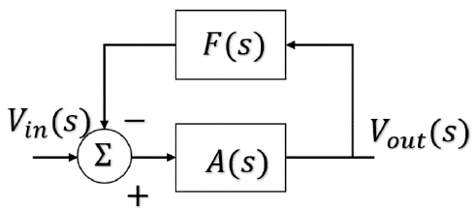
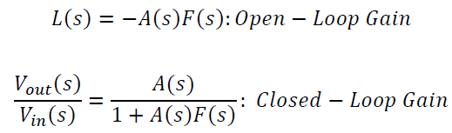
UNIT III CMOS OPERATIONAL AMPLIFIER
Compensation of Op Amps
Operational amplifiers are generally used in a negative-feedback configuration. In this way, the relatively high, inaccurate forward gain can be used with feedback to achieve a very accurate transfer function that is a function of the feedback elements only.
A(s) is the amplifier gain and will normally be the open-loop, differential voltage gain of the op amp, and F(s) is the transfer function for external feedback from the output of the op amp back to the input. The loop gain of this system will be defined as,
Loop gain = L(s) = -A(s)F(s)
A single negative-feedback system.

Slide 23




UNIT III CMOS OPERATIONAL AMPLIFIER
Compensation of Op Amps
It is of primary importance that the signal fed back to the input of the op amp be of such amplitude and phase that it does not continue to regenerate itself around the loop.
Should this occur, the result will be either clamping of the output of the amplifier at one of the supply potentials (regeneration at dc), or oscillation (regeneration at some frequency other than dc).
The requirement for avoiding this situation can be succinctly stated by the following equation:

Slide 24
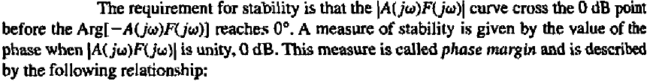
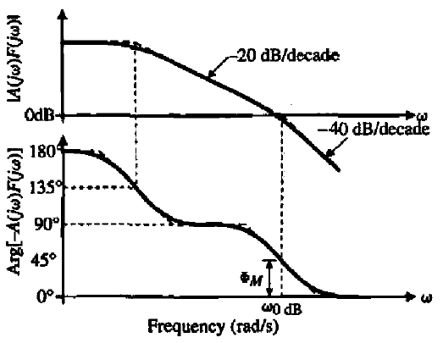
UNIT III CMOS OPERATIONAL AMPLIFIER
Compensation of Op Amps
Frequency and phase response of a second-order system.

Slide 25
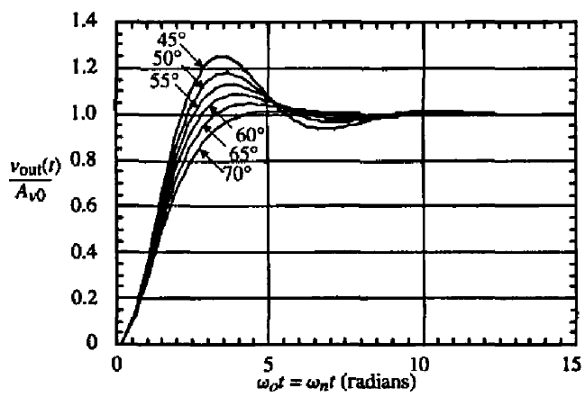
UNIT III CMOS OPERATIONAL AMPLIFIER
Compensation of Op Amps
One can see that larger phase margins result in less "ringing" of the output signal.
Too much ringing can be undesirable, so it is important to have adequate phase margin keeping the ringing to an acceptable level
It is desirable to have a phase margin of at least 45", with 60° preferable in most situations.
Response of a second-order system with various phase margins.

Slide 26
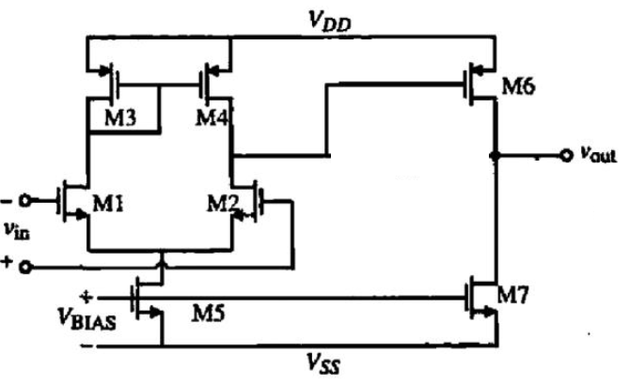
UNIT III CMOS OPERATIONAL AMPLIFIER
Un Compensated frequency response of the two stage Op Amps
An uncompensated two-stage operational amplifier has a two-pole transfer function, and these are located below the unity gain frequency.
Therefore, a frequency compensation circuitry must be implemented to ensure stability.
It is difficult to design a system with a truly single pole behavior; nevertheless, this desire behavior can be approximate over a frequency range that falls under the desire design specifications.

Slide 27
UNIT III CMOS OPERATIONAL AMPLIFIER
Un Compensated frequency response of the two stage Op Amps
Small Signal Model
D₁D₃ (C₁C₃)
D₂D₄ (C₂C₄)
D₆D₇ (C₆C₇)
C₁
C₂
C₃
R₁
R₂
R₃
V₂
V_{out}
g_{m1} V_{in}/2
V₁
g_{m4} V₁
g_{m6} V₂
g_{m2} V_{in}/2
Neglecting C_{GD} (Gate to Drain Capacitances).
R₁ = (1/g_{m3})||r_{ds3}||r_{ds1} =(1/g_{m3}); C₁ = C_{gs3}+C_{gs4}+C_{bd1}+C_{bd5}
R₂ = r_{ds2}||r_{ds4}; C₂ = C_{gs6}+C_{bd2}+C_{bd4}
R₃ = r_{ds6}||r_{ds7} =(1/g_{m3}); C₃ = C_{L}+C_{bd6}+C_{bd7}

Slide 28
UNIT III CMOS OPERATIONAL AMPLIFIER
Un Compensated frequency response of the two stage Op Amps
Assuming the poles due to the C₁ is much greater than the poles due to C₂ & C₃. So the equivalent circuit of Stage I and II is,
D₂D₄ (C₂C₄)
D₆D₇ (C₆C₇)
C₂
C₃
R₂
R₃
V₂
V_{out}
g_{m1} V_{in}
g_{m6} V₂
D₂D₄ (C₂C₄)
D₆D₇ (C₆C₇)
C_{I}
C_{II}
R_{I}
R_{II}
V_{I}
V_{out}
g_{m2} V_{in}
g_{mII} V_{I}

Slide 29
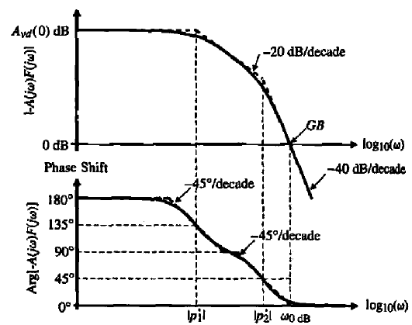
UNIT III CMOS OPERATIONAL AMPLIFIER
Un Compensated frequency response of the two stage Op Amps
R_{I} & R_{II} – Resistance to Ground from the output of First and Second Stage respectively.
C_{I} & C_{II} – Resistance to Ground from the output of First and Second Stage respectively.
P₁’= (-1/(R_{I}C_{I}))
P₂’= (-1/(R_{II}C_{II}))
Un Compensated frequency response of the two stage Op Amps with F(S) = 1
Note that F(s) = 1 is the worst case for stability considerations.
In Fig., the phase margin is significantly less than 45°, which means that the op amp should be compensated before using it in a closed-loop configuration.

Slide 30
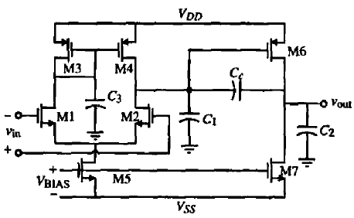
UNIT III CMOS OPERATIONAL AMPLIFIER
Miller Compensation of the two stage Op Amps
The first compensation method discussed here is the "Miller" compensation technique.
This technique is applied by connecting a capacitor from the output to the input of the second transconductance stage g_{mII}.
Two results come from adding the compensation capacitor Cc.
First, the effective capacitance shunting R_{I} is increased by the additive amount of approximately g_{mII}{R_{II})(Cc.). This moves p₁ (the new location of p’₁) closer to the origin of complex frequency plane by a significant amount (assuming that the second-stage gain is large).
Second, p₂ (the new location of p'₂) is moved away from the origin of the complex frequency plane, resulting from the negative feedback reducing the output resistance of the second stage.

Slide 31
UNIT III CMOS OPERATIONAL AMPLIFIER
Miller Compensation of the two stage Op Amps
The various capacitances are,
Cc – Miller compensation capacitance
C_{M} – Capacitance associated with the first stage mirrors (Mirror Pole)
C_{I} – Output Capacitance to Ground of the First stage
C_{II} – Output Capacitance to Ground of the First stage
Cc is additionally added for the compensation purpose. Other (C₌, C_{I}, C_{II}) capacitances are already present in the system (Parasitic Load).
Assume that,
g_{m3} >> g_{ds3} + g_{ds1}
(g_{m3}/C_{M}) >> GB (Gain Bandwidth)

Slide 32
UNIT III CMOS OPERATIONAL AMPLIFIER
Miller Compensation of the two stage Op Amps
C_{c}
V₁
V₂
V_{out}
1/g_{m3}
C_{M}
C_{I}
C_{II}
g_{m1} V_{in}/2
g_{m4} V₁
g_{m6} V₂
r_{ds1} || r_{ds3}
g_{m2} V_{in}/2
r_{ds2} || r_{ds4}
r_{ds6} || r_{ds7}

Slide 33
UNIT III CMOS OPERATIONAL AMPLIFIER
Miller Compensation of the two stage Op Amps
C_{c}
Simplified as,
N₁
V₂
N₂
V_{out}
C_{I}
C_{II}
V_{in}
g_{m1} V_{in}
g_{m6} V₂
r_{ds2} || r_{ds4}
r_{ds6} || r_{ds7}
Consider,
g_{mI} = g_{m1} = g_{m2}; R_{I} = r_{ds2} || r_{ds4}; C_{I} = C₁ and
g_{mII} = g_{m6}; R_{II} = r_{ds6} || r_{ds7}; C_{II} = C₁ = C_{L}
Applying Nodal equation,
At N₁:
0 = g_{mI} V_{in} + V₂ S C_{I} + V₂G_{I} + (V₂ – V_{out})S C_{c} ((1/R_{I}) = G_{I})
0 = g_{mI} V_{in} + V₂ [S (C_{I} + C_{c}) + G_{I}] – V_{out} S C_{c} ------- (1)
At N₂:
0 = g_{mII} V₂ + V_{out} G_{II} + V_{out} S C_{II} + (V_{out} – V₂)S C_{c} ((1/R_{II}) = G_{II})
0 = (g_{mII} – S C_{I} )V₂ + [S (C_{II} + C_{c}) + G_{II}] V_{out} ------- (2)

Slide 34
UNIT III CMOS OPERATIONAL AMPLIFIER
Miller Compensation of the two stage Op Amps
Rearranging,
V₂ = - [S (C_{II} + C_{c}) + G_{II}] V_{out} / (g_{mII} – S C_{I} ) ------- (3)
Sub. (3) in (1),
g_{mI} V_{in} - [S (C_{I} + C_{c}) + G_{I}] [S (C_{II} + C_{c}) + G_{II}] V_{out} / (g_{mII} – S C_{I} ) – V_{out} S C_{c} = 0 ------- (4)
Simplifying (4)
V_{out} /V_{in} = [(g_{mII} –SC_{I} )g_{mI}] / [(G_{II}G_{I}+G_{II}S(C_{I}+C_{c})+G_{II}S(C_{II}+C_{c})+S² (C_{I}C_{II}+C_{I} C_{c}+C_{II}C_{c})+g_{mII} SC_{c}]
------- (5)
D(s) = (1 – (S/P₁)) (1 – (S/P₂))
D(s) = (1 – S((1/P₁)-(1/P₂))) + (S²/P₁P₂)
P₁ = (-1 / (g_{mII} R_{I} R_{II}C_{c}); P₂ = (-g_{mII} / (C_{I}C_{II}+C_{I} C_{c}+C_{II}C_{c})) = -g_{mII} / C_{II} (Since C_{II} >>C_{c} >C_{I})

Slide 35
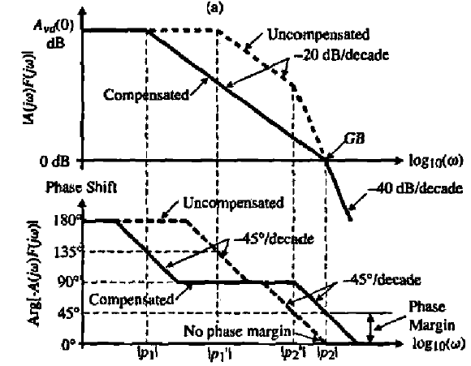
UNIT III CMOS OPERATIONAL AMPLIFIER
Miller Compensation of the two stage Op Amps
Replacing,
G_{I} = 1/R_{I} G_{II} = 1/R_{II} then (5) becomes,
V_{out}(S) /V_{in}(S)
= A₀[(1–S(C_{c}/g_{mII})] / [1+S(R_{I}(C_{I}+C_{II})+R_{II}(C_{c}+C_{II})+g_{mII}R_{I}R_{II}C_{c}) +S² (R_{I}R_{II} (C_{I}C_{II}+C_{I} C_{c}+C_{II}C_{c}))]
------- (6)
A₀ = g_{mI} g_{mII} R_{I} R_{II}
Unity Gain Bandwidth,
GB = A_{vd}(0) |P₁|
GB = (g_{mI} g_{mII} R_{I} R_{II}) / (C_{c} g_{mII} R_{I} R_{II})
GB = g_{mI} / C_{c} = g_{m1} / C_{c} = g_{m2} / C_{c}
A_{vd} = Voltage gain of Stage I &II

Slide 36
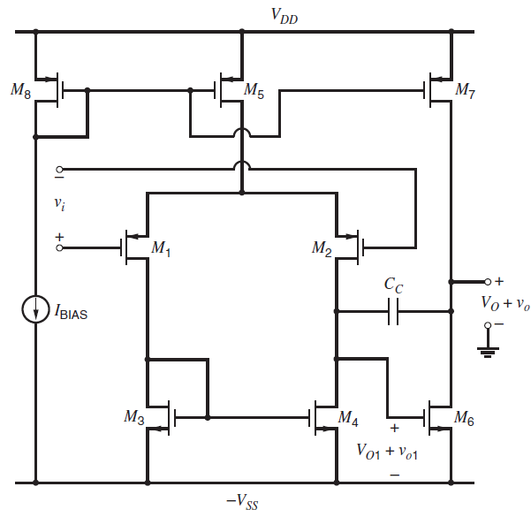
UNIT III CMOS OPERATIONAL AMPLIFIER
Two-stage amplifier with cascoded
The voltage gain that is available from the basic circuit shown in Fig. inadequate in a given application to achieve the required accuracy in the closed-loop gain.
For example, suppose the basic op amp uses transistors with g_{m}r_{o} = 20 and is connected in the voltage-follower configuration.
The given op-amp gain is less than (g_{m}r_{o})². Then the op-amp gain is about (g_{m}r_{o})², or 400 in this case.
The error in this approximation is one part in the op-amp gain or at least 0.25 percent.
In precision applications, this error may be too large to meet the given specifications, requiring an increase in the op-amp gain.
One approach to increasing the op-amp gain is to add another common-source gain stage to the op amp so that the overall gain is approximately (g_{m}r_{o})³ instead of (g_{m}r_{o})².
An important problem with this approach, however, stems from the fact that op amps are intended to be used in negative-feedback configurations.
Two-stage CMOS operational amplifier.

Slide 37
UNIT III CMOS OPERATIONAL AMPLIFIER
Two-stage amplifier with cascoded
Limitations:
In practice, op-amp frequency response is not constant.
If the op amp introduces an additional phase shift of 180º at some frequency, the negative feedback that was intended becomes positive feedback at that frequency, and the op amp may be unstable.
The key point here is that if an op amp is unstable in a given feedback configuration, it does not act as an amplifier but as a latch or oscillator.
To avoid this problem, op amps are usually designed with no more than two gain stages because each stage contains a node for which the impedance to ground is high and as a result contributes a significant pole to the op-amp transfer function.
Since the phase shift from one pole approaches −90º asymptotically, an op amp with no more than two poles cannot provide the 180o phase shift that is required to convert negative feedback into positive feedback.
To increase the voltage gain without adding another common-source gain stage, common gate transistors can be added.
Together with a common-source transistor, a common-gate transistor forms a cascode that increases the output resistance and gain of the stage while contributing a less significant pole to the amplifier transfer function than would be contributed by another common-source stage.

Slide 38
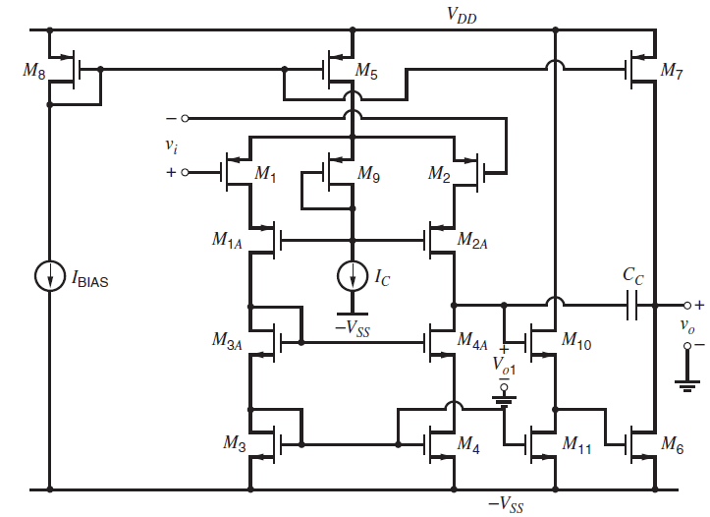
UNIT III CMOS OPERATIONAL AMPLIFIER
Two-stage amplifier with cascoded
Figure illustrates the use of cascodes to increase the voltage gain of a two-stage amplifier.
Here, a series connection of two transistors, one in the common-source connection and one in the common-gate connection, replace each common-source transistor in the first stage.

Slide 39
UNIT III CMOS OPERATIONAL AMPLIFIER
Two-stage amplifier with cascoded
Figure illustrates the use of cascodes to increase the voltage gain of a two-stage amplifier.
Here, a series connection of two transistors, one in the common-source connection and one in the common-gate connection, replace each common-source transistor in the first stage.
Therefore,M₁ andM_{1A} replace M₁. Similarly, M₂ and M_{2A} replace M₂.
Transistor M₉ and current source I_{C} have also been added to bias the gates of M_{1A} and M_{2A}.
In practice, the W/L of M₉ is chosen so that M₁ and M₂ are operated barely in the active region.
The effect of these replacements is to increase the unloaded output impedance of the differential pair by a factor that is approximately equal to g_{m}r_{o} of the cascode device.
If the current mirror M₃-M₄ were not also cascoded, however, the output resistance of the first stage including the current-mirror load would be limited by the mirror.
To overcome this limitation, a cascode current mirror is used. As a result, the stage gain and output resistance including the load are increased by approximately a factor g_{m}r_{o}.
In this circuit, M₁₀ and M₁₁ are included to level shift the output of the first stage down by V_{GS10} so that the second stage input is driven by a signal whose dc level is V_{GS3} above −V_{SS}.
Here, the op-amp gain here is on the order of (g_{m}r_{o})³ instead of (g_{m}r_{o})²
Disadvantage:
This circuit is a substantial reduction in the common-mode input range.
To overcome this problem, cascoding could be added instead to the second stage. In that case, however, the output swing of the op amp would be degraded by the cascodes.

Slide 40
UNIT III CMOS OPERATIONAL AMPLIFIER
MOS Telescopic-Cascode Operational Amplifiers
The Cascode configurations may be used to increase the voltage gain of CMOS transistor amplifier stages.
In many applications, the stage gain can be increased enough so that a single common-source–common-gate stage can provide enough voltage gain to meet the accuracy requirements.
The first stage of Fig. is sometimes used by itself as an op amp and provides a comparable gain.
This structure has been called a telescopic-cascode op amp because the cascodes are connected between the power supplies in series with the transistors in the differential pair, resulting in a structure in which the transistors in each branch are connected along a straight line like the lenses of a refracting telescope.
Advantage of telescopic cascode op amps is that they can be designed so that the signal variations are entirely handled by the fastest-polarity transistors in a given process.
Disadvantage of the telescopic-cascode configuration is that the output swing is small.

Slide 41
UNIT III CMOS OPERATIONAL AMPLIFIER
MOS Telescopic-Cascode Operational Amplifiers
For example, ignore M₆, M₇, M₁₀, M₁₁, and C_{C} in Fig. and define the dc op-amp output voltage as the voltage V_{O1} from the drains of M_{2A} and M_{4A} to ground.
For simplicity, assume that all transistors are enhancement mode with identical overdrive magnitudes.
To calculate the output swing, first consider the cascode current mirror by itself. If V_{SS} = 0, the minimum output voltage for which M₄ and M_{4A} operate in the active region

Slide 42
UNIT III CMOS OPERATIONAL AMPLIFIER
MOS Telescopic-Cascode Operational Amplifiers
With nonzero V_{SS}, this condition becomes
V_{O1(min)} = −V_{SS} + V_{ds4A} + V_{ds4} ----- (1)
V_{O1(min)} = −V_{SS} + V_{gs4A} + V_{gs4}
(Diode Connected => V_{ds} = V_{gs} = V_{tn} + V_{ov})
V_{O1(min)} = −V_{SS} + V_{tn} + 2V_{ov} ----- (2)
The presence of a threshold term in this equation is an important limitation because it causes a substantial reduction in the allowed output swing. Fortunately, this limitation can be overcome by using one of the high-swing cascode current mirrors
V_{O1(min)} = −V_{SS} + 2V_{ov} ----- (3)
With this change, we can see that to achieve a gain comparable to (g_{m}r_{o})² in one stage, the swing is limited at best to two overdrives away from the supply.

Slide 43
UNIT III CMOS OPERATIONAL AMPLIFIER
MOS Telescopic-Cascode Operational Amplifiers
To find the maximum output voltage swing of the telescopic-cascode op amp, Assume that the common-mode input from the gates of M₁ and M₂ to ground is V_{IC}.
The voltage from the source of M₁ and M₂ to ground is
0 = V_{G} – V_{S} + V_{DS5}
V_{S} = V_{G} + V_{DS5} (V_{ds} = V_{gs} = V_{tp} + V_{ov} and V_{G} = V_{IC})
V_{S} = V_{IC} + |V_{tp}| + |V_{ov}| ----- (4)
To operateM₅ in the active region, its source-drain voltage should be at least |Vov |. Therefore,
V_{DD} − V_{S} ≥ |V_{ov} | ----- (5)
Sub. (4) in (5), we get,
V_{DD} − V_{IC} − |V_{tp}| − |V_{ov}| ≥ |V_{ov} | ----- (6)
V_{IC} ≤ V_{DD} − |V_{tp}| − 2|V_{ov}| ----- (7)
If we assume that M₉ and I_{C} are chosen to operate M₁ and M₂ at the edge of the active region, the maximum output voltage for which M₂ and M_{2A} operate in the active region is
V_{O1(max)} = V_{S} − 2|V_{ov} | ----- (8)
Sub. (4) in (7), we get,
V_{O1(max)} = V_{IC} + |V_{tp}| − |V_{ov}| ----- (9)

Slide 44
UNIT III CMOS OPERATIONAL AMPLIFIER
MOS Telescopic-Cascode Operational Amplifiers
The above equation shows another limitation of the telescopic-cascode op amp from the standpoint of output swing; that is, the maximum output voltage depends on the common-mode input.
Assuming that the op-amp inputs are biased to the maximum common-mode input voltage for which M₅ operates in the active region, the maximum output voltage can be found by substituting the maximum V_{IC},
V_{O1(max)} = V_{DD} − 3|V_{ov}| ----- (10)
This equation shows that the maximum output voltage of a telescopic op amp that consists of the first stage with optimum common-mode input biasing is three overdrives less than the positive supply.
This result stems from the observation that three transistors (M₅, M₂, and M_{2A}) are connected between V_{DD} and the output.
The minimum required supply voltage difference is ,
V_{O1(max)} − V_{O1(min)} = V_{DD} − (−V_{SS}) − 5|V_{ov}| ----- (11)
V_{DD} − (−V_{SS}) = V_{O1(max)} − V_{O1(min)} + 5|V_{ov}| ----- (12)
This equation shows that the minimum difference between the supply voltages in a telescopic cascode op amp must be at least equal to the peak-to-peak output signal swing plus five overdrive voltages to operate all transistors in the active region.

Slide 45
UNIT III CMOS OPERATIONAL AMPLIFIER
MOS Telescopic-Cascode Operational Amplifiers
Two main limitations:
First, if transistors are deliberately biased at the edge of the active region, a small change in the process, supply, or temperature may cause one or more transistors to operate in the triode region, reducing the output resistance and gain of the op amp. To avoid this problem, transistors in practical op amps are usually biased so that the magnitude of the drain-source voltage of each transistor is more than the corresponding overdrive by a margin of typically at least one hundred millivolts. The margin allowed for each transistor directly adds to the minimum required supply voltage difference.
Second, this calculation determines the supply requirements only for transistors between the output node and each supply, and other branches may require a larger supply difference

Slide 46
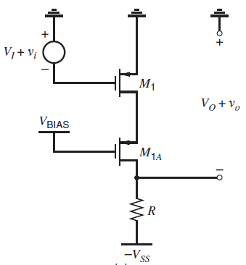
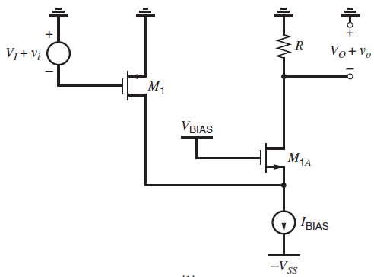
UNIT III CMOS OPERATIONAL AMPLIFIER
MOS Folded-Cascode Operational Amplifiers
Two cascode circuits where V_{DD} = 0 for simplicity.
Standard cascode configuration.
Folded-cascode configuration.
Both M₁ and M_{1A} are p-channel devices.
M₁ is a p-channel device but M_{1A} is an n-channel device.
In both cases, however,M1 is connected in a common-source configuration, and M_{1A} is connected in a common-gate configuration. Small-signal variations in the drain current of M1 are conducted primarily through M_{1A} in both cases because I_{BIAS} is a constant current source. Therefore, both circuits are examples of cascodes.

Slide 47
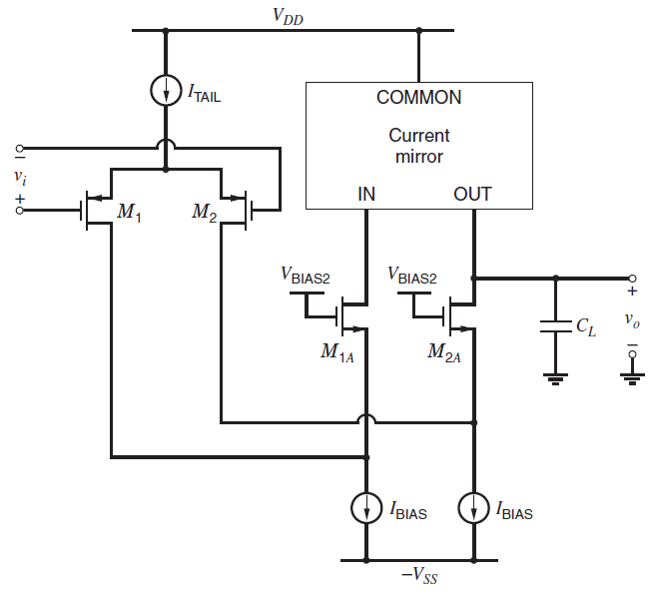

UNIT III CMOS OPERATIONAL AMPLIFIER
MOS Folded-Cascode Operational Amplifiers
The cascode in previous Fig.b is said to be folded in the sense that it reverses the direction of the signal flow back toward ground.
This reversal has two main advantages when used with a differential pair.
It increases the output swing.
It increases the common-mode input range.
Figure shows a simplified schematic of a circuit that applies the folded-cascode structure to both sides of a differential pair.
M₁ and M_{1A} form one cascode structure; Also, M₂ and M_{2A} form another.
The current mirror converts the differential signal into a single-ended output by sending variations in the drain current of M_{1A} to the output. The resulting op amp is called a folded-cascode op amp.
Bias is realized by making the currents in current sources M₁₁ and M₁₂ larger than |I_{D5}|/2.
Simplified
folded-cascode op amp.

Slide 48
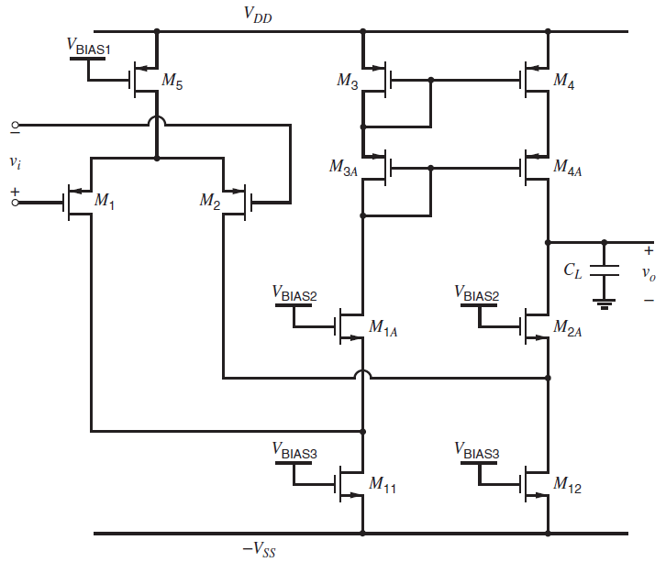
UNIT III CMOS OPERATIONAL AMPLIFIER
MOS Folded-Cascode Operational Amplifiers
Compared to the other op-amp configurations we have considered, the folded-cascode configuration improves the common-mode input range.
The upper end of the range is the same as in the basic two-stage op amp and the telescopic cascode op amp.
On the other hand, the lower end of the range can be reduced significantly compared to both of the other configurations if V_{BIAS2} is adjusted so that M₁₁ and M₁₂ operate at the edge of the active region.
Under this condition, the bias voltage from the drain of M₁ to −V_{SS} is V_{ov11}, which can be much less than in the other configurations.
Detailed folded-cascode op amp.

Slide 49
UNIT III CMOS OPERATIONAL AMPLIFIER
MOS Folded-Cascode Operational Amplifiers
To calculate the output swing, first consider the p-type cascode current mirror by itself.
Since M₃ and M_{3A} are diode connected, the voltage from V_{DD} to the gate of M_{4A} is 2|V_{tp}| + 2|V_{ov} |.
Therefore, the source-drain voltage of M₄ is |V_{tp}| + |V_{ov}|, and the maximum output for which both M₄ and M_{4A} operate in the active region is,
V_{OUT(max)} = V_{DD} − |V_{tp}| − 2|V_{ov}|
The threshold term in this equation can be eliminated by using a p-type version of one of the high-swing cascode current mirrors,
V_{OUT(max)} = V_{DD} − 2|V_{ov}|
the minimum output voltage, assume that V_{BIAS2} is adjusted so that M₁₂ operates at the edge of the active region. Then the drain-source voltage of M₁₂ is V_{ov} and the minimum output voltage for which both M_{2A} and M₁₂ operate in the active region is,
V_{OUT(min)} = −V_{SS} + 2V_{ov}
The small-signal voltage gain of this circuit at low frequencies is
Av = G₌R_{o}

Slide 50
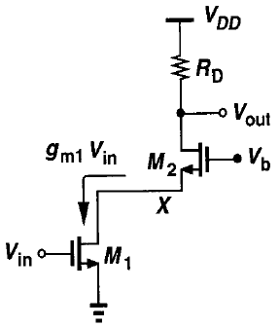
UNIT III CMOS OPERATIONAL AMPLIFIER
MOS Active-Cascode Operational Amplifiers
One way to increase the gain of the folded-cascode op amp without cascading additional stages is to add another layer of cascodes.
Although this approach gives a gain on the order of (g_{m}r_{o})³, it reduces the output swing by at least another overdrive in each direction.
This reduction becomes increasingly important as the difference between the power-supply voltages is reduced in scaled technologies.
To increase the op-amp gain without reducing the output swing, the active-cascode technique can be used.
Cascode Stage Amplifier
G₂
D₂
x
I_{x}
I_{r0}
r_{o2}
V_{x}
g_{m2} V_{gs2}
g_{mb2} V_{bs2}
S₂
D₁
I_{out}
G₁
r₀₁
g_{m1} V_{gs1}
S₁

Slide 51
UNIT III CMOS OPERATIONAL AMPLIFIER
MOS Active-Cascode Operational Amplifiers
To find Trans-conductance,
V_{o} = Voltage drop in r_{o1} + Voltage drop in r_{o2}
I_{o} = g_{m2} V_{gs2} + g_{mb2} V_{bs2} + (-V_{s2}/ r_{o2})
I_{o} = g_{m2} (-V_{s2}) + g_{mb2} (-V_{s2}) + (-V_{s2}/ r_{o2})
I_{o} = (-V_{s2}) [(g_{m2} + g_{mb2} + (1/ r_{o2})] ----- (1)
V_{s2} = I_{o} – (g_{m1} V_{i}) r_{o1} ----- (2)
g_{mb2} = η g_{m2} ----- (3)
Sub. (2) & (3) in (1),
I_{o} = – (I_{o} – (g_{m1} V_{i}) r_{o1}) [(g_{m2} + η g_{m2} + (1/ r_{o2})] ----- (4)
Simplifying the above (4),
g_{m} = I_{o}/V_{i} = [(g_{m1} r_{o1} /r_{o2}) +(g_{m2} (1+ η) g_{m1} r_{o1})] / [(r_{o1} /r_{o2})+(1+ η) g_{m2} r_{o1})] ----- (5)

Slide 52
UNIT III CMOS OPERATIONAL AMPLIFIER
MOS Active-Cascode Operational Amplifiers
To find output resistance,
I_{x} = g_{m2} V_{gs2} + g_{mb2} V_{bs2} + (V_{x} – V_{s2})/r_{o2} ----- (6)
I_{x} = g_{m2} (V_{g2} –V_{s2}) + ηg_{m} (V_{b2}-V_{s2}) + (V_{x} – V_{s2})/r_{o2} ----- (7)
V_{s2} = I_{x}r_{o1}; R₀ = V_{x}/I_{x} ; V_{b2} = V_{g2} =0
I_{x} = g_{m2} (0 – I_{x}r_{o1}) + ηg_{m} (0 - I_{x}r_{o1}) + (V_{x} – I_{x}r_{o1})/r_{o2}
I_{x} + g_{m2}I_{x}r_{o1} + ηg_{m}I_{x}r_{o1} + I_{x}r_{o1}/r₀₂ = V_{x}/r_{o2}
I_{x} (1 + g_{m2} r_{o1} + ηg_{m} r_{o1} + r_{o1}/r₀₂) =V_{x}/r_{o2}
R₀ = V_{x}/I_{x} = (1 + g_{m2} r_{o1} + ηg_{m} r_{o1} + r_{o1}/r_{o2}) r_{o2}
R₀ = V_{x}/I_{x} = (r_{o2} + g_{m2} r_{o1} r_{o2} + ηg_{m} r_{o1} r_{o2} + r_{o1}) ----- (8)

Slide 53
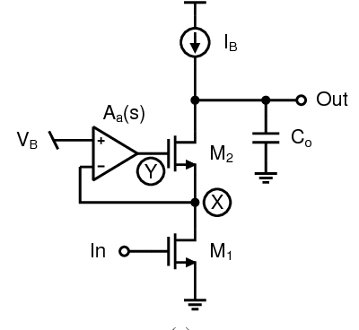
UNIT III CMOS OPERATIONAL AMPLIFIER
MOS Active-Cascode Operational Amplifiers
In previous CS-CG configuration V_{g2} = 0.
Here,
V_{gs2} = V_{g2} - V_{s2} = -aV_{s2} - V_{s2}
V_{gs2} = - (1+a) V_{s2}
‘a’ is the gain of the active op-amp.
(-) sign indicates the negative feedback.
When V_{o} increasing, I_{D2} also increasing, which increases the I_{D1}+V_{DS1}. This potential is amplified by “-a”, due to which the voltage from gate of M₂ tends to fall.
Reduction of gate voltage of M₂ causes reduction in drain current and also R_{o} increases.

Slide 54
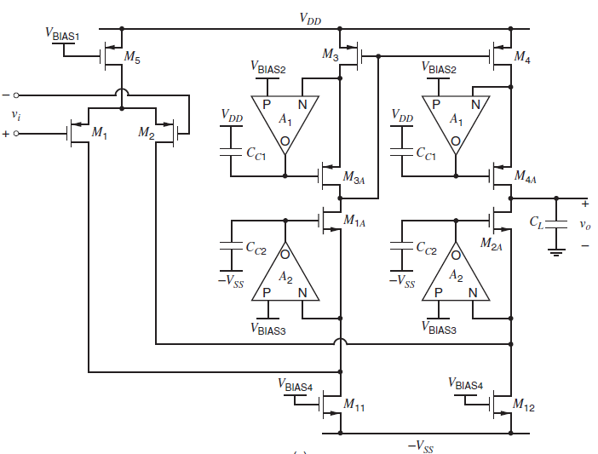
UNIT III CMOS OPERATIONAL AMPLIFIER
MOS Active-Cascode Operational Amplifiers
The gates of each of the four cascode transistors M_{1A}, M_{2A}, M_{3A}, and M_{4A} are connected to the output of an amplifier.
These auxiliary amplifiers are themselves connected in negative feedback loops to increase the resistance looking into the drain of each cascode transistor.
The active-cascode configuration increases the output resistance by increasing the effective transconductance of the cascode transistor by (a + 1), where a is the voltage gain of the amplifier.
Let the gains of the auxiliary amplifiers driving M_{3A} and M_{4A} be A₁.
For the MOS active cascode, the g_{m} is,
replace g_{m2} = (1+a) g_{m2} in eqn. (5),
Hence,
g_{m}=I_{o}/V_{i}=[(g_{m1}r_{o1}/r_{o2}) +(g_{m2}(1+a)g_{m1}r_{o1})+(g_{mb2}g_{m1}r_{o1})] / [(r_{o1}/r_{o2})+((1+ a)g_{m2} r_{o1})+ g_{mb2} r_{o1}]
R₀ = V_{x}/I_{x} = (r_{o2} + (g_{m2} (1+a) + g_{mb2}) r_{o1} r_{o2} + r_{o1})

Slide 55
UNIT III CMOS OPERATIONAL AMPLIFIER
MOS Active-Cascode Operational Amplifiers
The output resistance looking into the drain of M4A gives
R_{out|M4A} = r_{o4} + r_{o4A}{1 + [g_{m4A}(A₁ + 1) + g_{mb4A}](r_{o4})}
R_{out|M4A} = (A₁ + 1)(g_{m4}Ar_{o4})r_{o4A}
The output resistance looking into the drain of M2A gives
R_{out|M2A} = (r_{o2}||r_{o12}) + r_{o2A}{1 + [g_{m2A}(A₂ + 1) + g_{mb2A}](r_{o2}||r_{o12})}
R_{out|M2A} = (A₂ + 1)[g_{m2A}(r_{o2} || r_{o12})]r_{o2A}
The overall gain is,
A_{V} = G_{m} R_{o}
A_{V} = G_{m} [R_{out} at M_{2A} || R_{out} at M_{4A}]

Slide 56
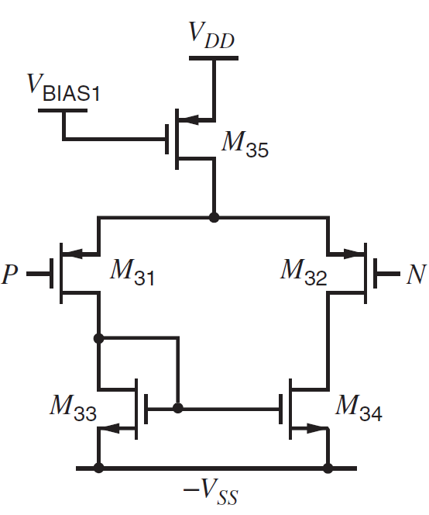
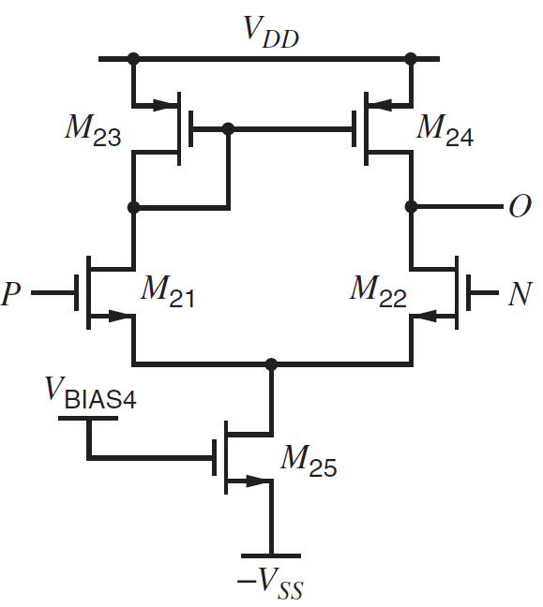
UNIT III CMOS OPERATIONAL AMPLIFIER
MOS Active-Cascode Operational Amplifiers
Auxiliary amplifier with gain A₁
Auxiliary amplifier with gain A₂
A₁ transistors (amplifier) operates with P-channel differential input pair, then,
Common mode input voltage V_{IC} = V_{DD} – V_{tp} – 2V_{ovp}
If A₁ transistors (amplifier) operates with N-channel differential input pair, then,
Common mode input voltage V_{IC} = V_{DD} + V_{tp} + 2V_{ovp}

Slide 57
UNIT III CMOS OPERATIONAL AMPLIFIER
Low Noise CMOS Op-amps
Low-noise op amps are important in applications where a large dynamic range is required.
The dynamic range can be expressed as the signal-to-noise ratio (SNR).
The significance of dynamic range can be appreciated when considering the dynamic range necessary for signal resolution in terms of digital bits.
In addition to noise as a lower limit, one must also consider the linearity of the op amp. If the op amp is nonlinear, then a pure sinusoidal signal will generate harmonics. If the total harmonic distortion (THD) of these harmonics exceeds the noise, then nonlinearity becomes the limiting factor.
Sometimes the notation of signal-to-noise plus distortion (SNDR) is used to include both noise and distortion in the dynamic range consideration.
One should also consider the influence of unwanted signals such as power-supply injection or charge injection (due to switches).
Low-noise op amps must have a sufficiently high PSRR in order to achieve the desired lower limit of the dynamic range.

Slide 58

UNIT III CMOS OPERATIONAL AMPLIFIER
Low Noise CMOS Op-amps
The noise in a MOSFET was modeled as a mean-square current generator in the channel
The noise of the MOSFET consists of two parts.
The first part is the thermal noise and the second is called the 1/f noise.
The 1/f noise is only important at low frequencies because it varies inversely with frequency. However, the 1/f noise is aliased around clock frequencies and therefore becomes significant even at higher frequencies.
Minimizing noise in Op-amps:
Maximize the signal gain as close to the input as possible.
To minimize the 1/f noise,
Use PMOS input with appropriate (W/L).
Use lateral BJT to eliminate 1/f noise.
Use Chopper Stabilization.

Slide 59
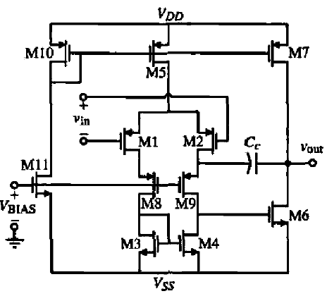
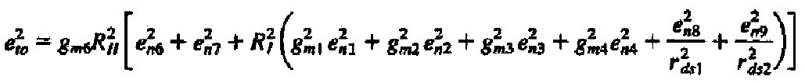
UNIT III CMOS OPERATIONAL AMPLIFIER
Low Noise CMOS Op-amps
PMOS transistors have about two to five times less l/f noise than NMOS transistors. Therefore, PMOS transistors should be used where it is important to reduce the l/f noise.
The one principle that is key in minimizing noise is to make the first stage gain as high as possible.
This means that if the input is a differential amplifier, the source-coupled transistors should be PMOS and the gain of the differential amplifier must be as large as possible.
This op amp is similar to the two-stage op amp, except for the cascode devices, M8 and M9, which are used to improve the PSRR.
Also, returning the compensation capacitor to the source of M9 allows the output pole to be increased. PMOS devices are selected for the input of the differential stage because of their lower l/f noise.
The total output-voltage-noise spectral density, e_{to}² is,

Slide 60
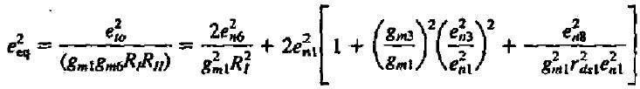
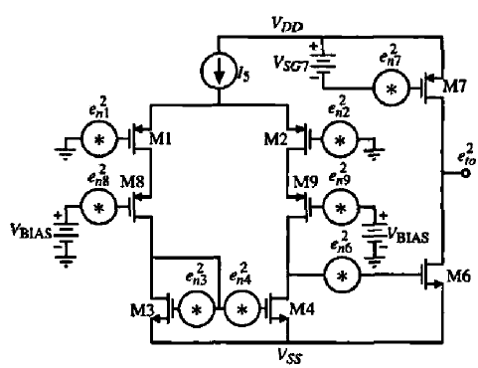

UNIT III CMOS OPERATIONAL AMPLIFIER
Low Noise CMOS Op-amps
The noise contribution of the second stage is divided by the gain of the first stage and can therefore be neglected.
Also, the noise of the cascode transistors, M8 and M9, is divided by (g_{m1}r_{ds1})², which means that their contribution can be neglected.
The resulting equivalent input-voltage noise spectral density can be approximately expressed as
Noise model of Low noise op-amp

Slide 61



UNIT III CMOS OPERATIONAL AMPLIFIER
Low Noise CMOS Op-amps
Now we must select the model to be inserted in the spectral density noise sources in low noise op-amp. Because we are focusing on 1/f noise we will replace these sources by
if the source is Voltage
if the source is Current
Substituting the appropriate choice for the spectral density noise sources
Because we have selected PMOS devices as the input (M_{I} and M₂) the value of e_{n1}² been minimized if we choose the product of W₁ and L₁ (W₂ and L₂) large. Next, we have to reduce the value of the term in the square brackets of the above Eqn.
The only variable available to do so is the ratios of L₁to L₂, Selecting these ratios less than one gives an equivalent input spectral noise density of 2 e_{n1}² .

Slide 62




UNIT III CMOS OPERATIONAL AMPLIFIER
Low Noise CMOS Op-amps
For completeness sake, let us find the equivalent input spectral noise density if thermal noise is of concern.
if the source is Voltage
if the source is Current
Substituting the appropriate choice for the spectral density noise sources,
The noise concern where the thermal noise is equal to the 1/f noise can be found for a single transistor as,

Slide 63
UNIT III CMOS OPERATIONAL AMPLIFIER
Low Voltage CMOS Op-amps
As CMOS technology continues to shrink in size, there are several important implications that result.
The motivation for decreasing the channel length is to increase the MOSFET frequency and to allow more circuits to be implemented in the same physical area, which sustains the move from very large-scale integrated (VLSI) circuits to ultra large-scale integrated (ULSI) circuits.
The reduction in voltage comes about because the reduced dimensions reduce the voltage breakdowns of the technology.
In addition, the power dissipation in digital circuits in proportional to the square of the power supply.
In order to reduce the power dissipation in ULSl circuits, it is necessary to either cool the chip or to reduce the power supply or both.
As the power-supply voltages are decreased, the dynamic range of the analog signals is decreased.
If the threshold voltage is scaled with the power-supply voltage, the dynamic range would not be strongly affected.
If the threshold voltage is too close to zero, appreciable current would flow in the MOSFET logic devices even when they are off.
If this small current is multiplied by thousands of devices, it becomes a significant samount of power dissipation.

Slide 64
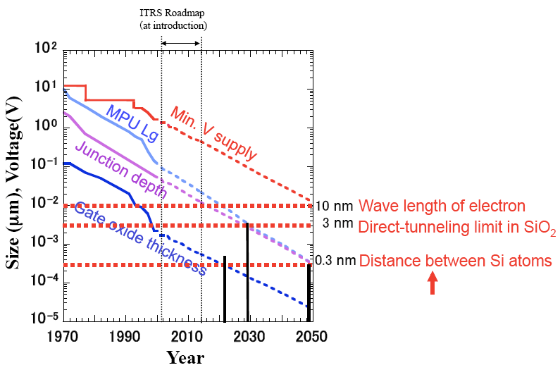
UNIT III CMOS OPERATIONAL AMPLIFIER
Low Voltage CMOS Op-amps
The best threshold for logic to give the highest noise margin is approximately halfway between power supply.
If a 1.5 V power supply is used, then 0.75 V thresholds give more noise margin.
Consequently, the analog designer will have to face the issue of decresing power supplies with approximately constant threshold voltages.
Implications of Low-Voltage, Strong Inversion Operation
As the power supply decreases, the dynamic range will decrease.
Use of differential operation will help to increase the signal swing.
For the dynamic range to decrease proportionally with the power supply.
The noise and nonlinearity must remain constant.
Unfortunately, with reduced power supply, the nonlinearity will general increase.
The W/L values of MOSFETs are very large in order to make V_{DS}(sat) small so that the noise tends to remain constant or decrease.

Slide 65
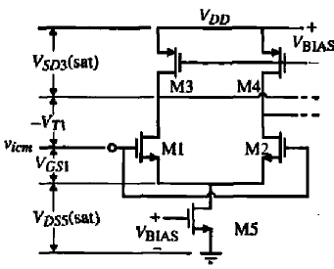


UNIT III CMOS OPERATIONAL AMPLIFIER
Low Voltage CMOS Op-amps
Low-Voltage Input Stages
Probably the most serious influence of low-voltage power supplies is on the input stage of the op amp. The minimum value of power supply that can be used is given as,
Assuming equal saturation voltages of 0.3 V and a threshold voltage of 0. 7 V gives a power supply of 0.9 V.
The upper limit is given as
The lower limit as,
Input common-mode range of a differential input stage.

Slide 66
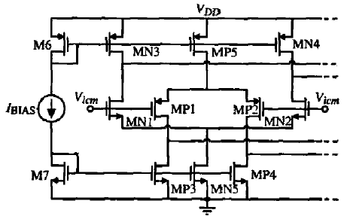

UNIT III CMOS OPERATIONAL AMPLIFIER
Low Voltage CMOS Op-amps
One of the solutions to this problem is to use both an n-channel differential input stage and a p-channel differential input stage in parallel.
if we carefully examine the operation of Fig. over the input common-mode range, we find that there are three regions of operation.
For example, when V_{icm} is less than V_{DS}(sat)+V_{GS,} not all of the transistors in the n-channel input are operating in saturation.
In fact the current in MN1 and MN2 continue to flow because of the current sources MN3 and MN4.
Thus, V_{GSNI} remains constant and the current sink of the n-channel differential amplifier, MN5, goes into the active region.
As this happens the current in MN1 and MN2 decreases, causing the drains of MN1 and MN2 (MN3 and MN4) to go to V_{DD}. turning off the n-channel stage..
Parallel n-channel and p-channel differential input stage.
The tum-on voltage for the n-channel differential input stage is,

Slide 67

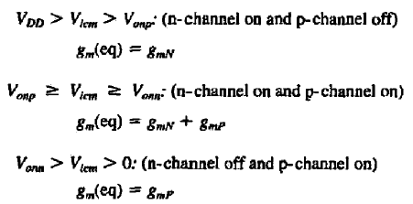
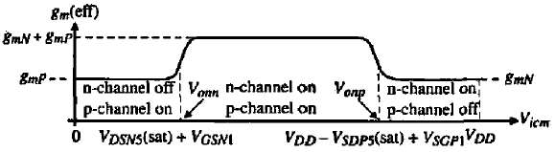
UNIT III CMOS OPERATIONAL AMPLIFIER
Low Voltage CMOS Op-amps
A similar occurrence happens to the p-channel input differential amplifier and the turn-on voltage for the p-channel differential input stage and is given as,
Between these voltages, all transistors of both differential inputs are in saturation. The difficulty with this result is that the small-signal input transconductance varies as a function of the common-mode input signal, V_{icm.}

Slide 68

UNIT III CMOS OPERATIONAL AMPLIFIER
Low Voltage CMOS Op-amps
Low-Voltage Bias and Load Circuits
In addition to the input stage of an op amp, the biasing and load circuits can become a limit to power-supply reduction.
We have seen that the simple current mirror requires a gate-source voltage drop at the input to function properly.
This voltage can be as much 1 V or more depending on the WIL and the current. The minimum power supply would be the voltage plus a saturation voltage of a current source or sink.
There are two ways of decreasing the voltage required across the input of the current mirror.
One is to use bulk-driven devices and the other is to level shift the drain voltage below the gate voltage.

Slide 69
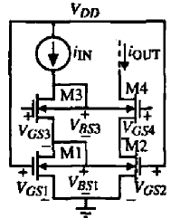
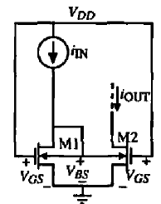
UNIT III CMOS OPERATIONAL AMPLIFIER
Low Voltage CMOS Op-amps
Simple bulk-driven current mirror
Cascode bulk-driven current mirror
The gates are taken to V_{DD} to form the channels in Ml and M2.
If the value of i_{IN} is greater than I_{DSS} then V_{DS} is greater than zero and the current mirror functions as a normal current mirror.
The minimum input voltage of the current mirror is equal to the sum of the bulk-source voltages for Ml and M3.
Again, the value of i_{IN} must be greater than I_{DSS} of the transistors.

Slide 70
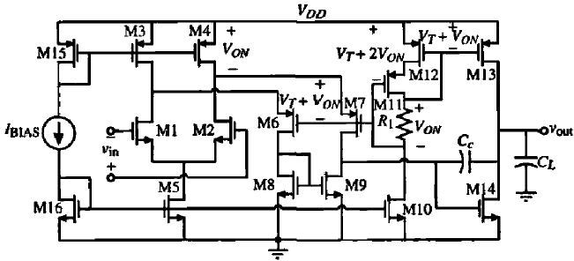
UNIT III CMOS OPERATIONAL AMPLIFIER
Low Voltage CMOS Op-amps
A low-voltage, two-stage op amp having V_{DD} = 2V_{T}
The input stage is the simple n-channel differential amplifier with current source loads.
This gives the widest possible input common-mode range for enhancement MOSFETs without using the parallel input stages.
The p-channel transistors whose sources are connected to the output of the differential amplifier are biased.
The signal currents of the differential output are folded through these transistors (M6 and M7) and converted to single-ended signals with the n-channel current mirror (M8 and M9).
Finally, a simple Class A output stage using Miller compensation is used for the second-stage gain.

